Slide 1
MATHEMATICS OF CRYPTOGRAPHY PART I MODULAR ARITHMETIC AND CONGRUENCE

Slide 2
Book : Cryptography and Network security by Behrouz A. Forouzan

Slide 3
Integer Arithmetic
In integer arithmetic, we use a set and a few operations.
Reviewed here to create a background for modular arithmetic.

Slide 4

Set of Integers
The set of integers, denoted by Z, contains all integral numbers (with no fraction) from negative infinity to positive infinity
The set of integers

Slide 5
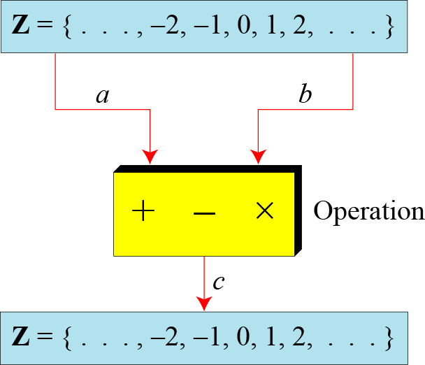
Binary Operations
In cryptography, we are interested in three binary operations applied to the set of integers.
A binary operation takes two inputs and creates one output.
The set of integers
Three binary operations for the set of integers

Slide 6
Integer Division
In integer arithmetic, if we divide a by n, we can get q and r.
The relationship between these four integers can be shown as
a = q × n + r

Slide 7
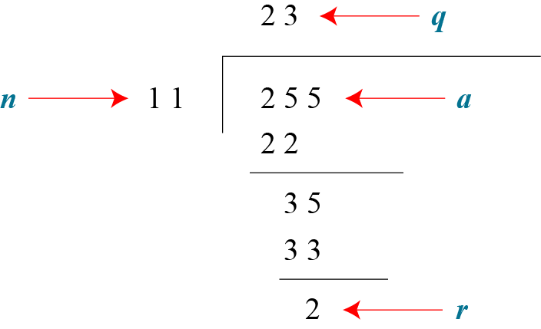
Integer Division(cont.)
Assume that a = 255 and n = 11. We can find q = 23 and r = 2 using the division algorithm.
Finding the quotient and the remainder

Slide 8
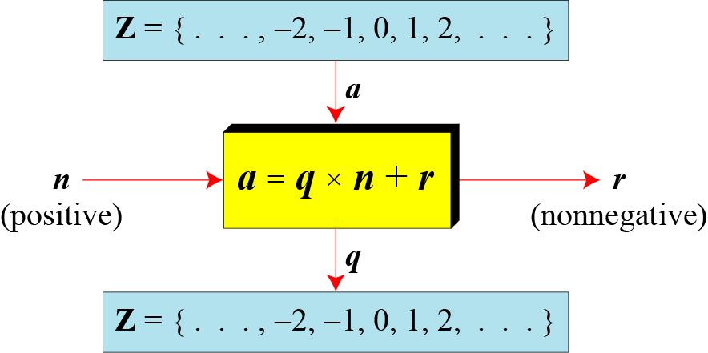
Integer Division(cont.)
Division algorithm for integers

Slide 9
Integer Division(cont.)
When we use a computer or a calculator, r and q are negative when a is negative.
How can we apply the restriction that r needs to be positive?
The solution is simple, we decrement the value of q by 1 and we add the value of n to r to make it positive.

Slide 10
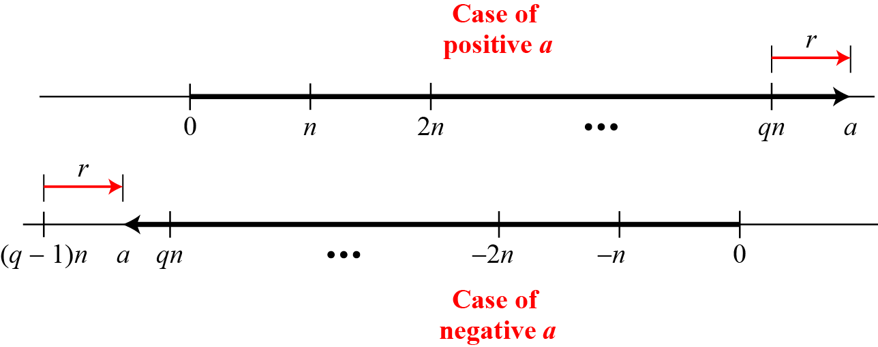
Integer Division(cont.)
Graph of division algorithm

Slide 11
Divisibility
If a is not zero and we let r = 0 in the division relation, we get
If the remainder is zero, n | a
If the remainder is not zero, n | a
a = q × n

Slide 12
Divisibility(cont.)
Properties
Property 1: if a|1, then a = ±1.
Property 2: if a|b and b|a, then a = ±b.
Property 3: if a|b and b|c, then a|c.
Property 4: if a|b and a|c, then a|(m × b + n × c), where m and n are arbitrary integers

Slide 13
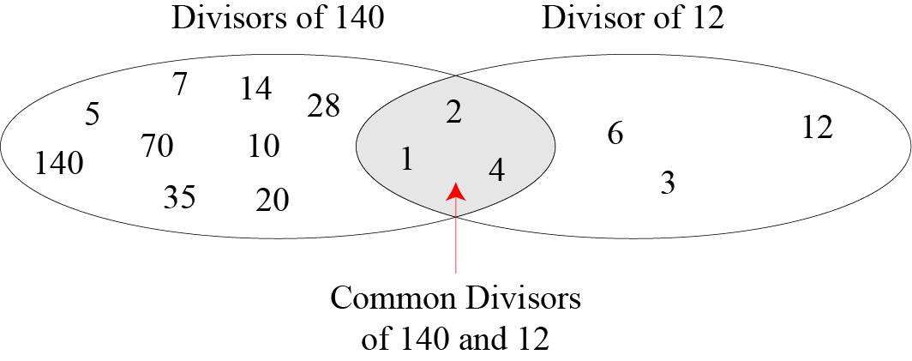
Divisibility(cont.)
Common divisors of two integers

Slide 14
Divisibility(cont.)
Greatest Common Divisor
The greatest common divisor of two positive integers is the largest integer that can divide both integers.
Euclidean Algorithm
Fact 1: gcd (a, 0) = a Fact 2: gcd (a, b) = gcd (b, r), where r is the remainder of dividing a by b

Slide 15
Divisibility(cont.)
For example, to calculate the gcd(36,10), we use following steps:
gcd (36, 10) = gcd (10, 6)……..by fact 2
gcd (10, 6) = gcd (6, 4)…………by fact 2
gcd (6, 4) = gcd (4, 2)………….by fact 2
gcd (4, 2) = gcd (2, 0)…………by fact 2
gcd (2, 0) = 2…………………….by fact 1
Hence, Answer = 2

Slide 16
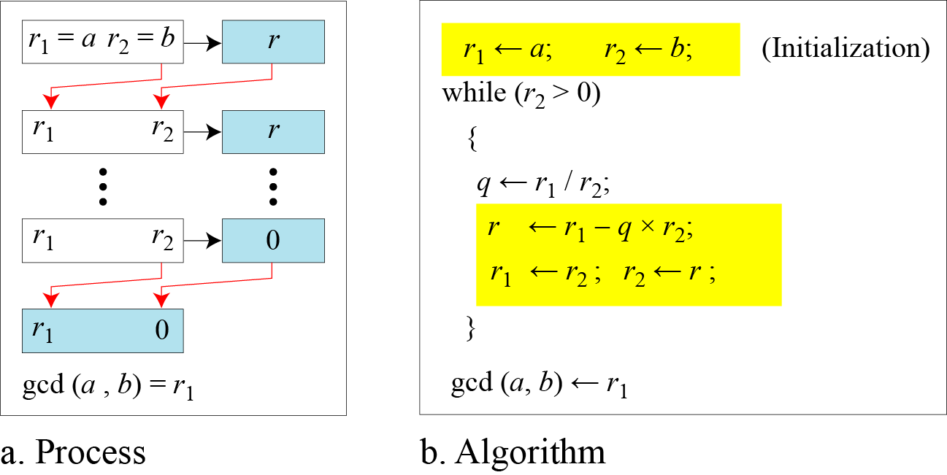
Divisibility(cont.)
Euclidean Algorithm
When gcd (a, b) = 1, we say that a and b are relatively prime.

Slide 17
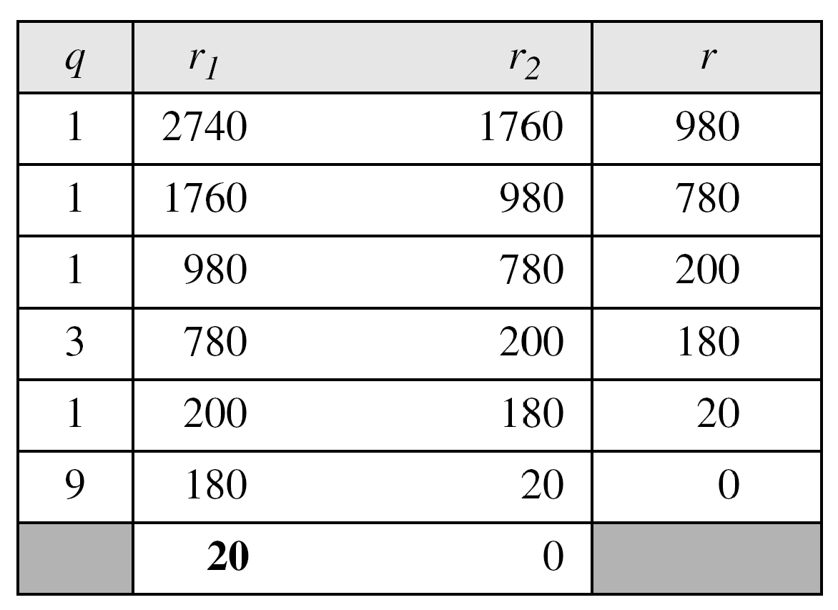
Divisibility(cont.)
Find the greatest common divisor of 2740 and 1760.
Answer: gcd (2740, 1760) = 20.

Slide 18
Divisibility(cont.)
Find the greatest common divisor of 25 and 60.

Slide 19

Divisibility(cont.)
Extended Euclidean Algorithm
Given two integers a and b, we often need to find other two integers, s and t, such that
The extended Euclidean algorithm can calculate the gcd (a, b) and at the same time calculate the value of s and t.

Slide 20
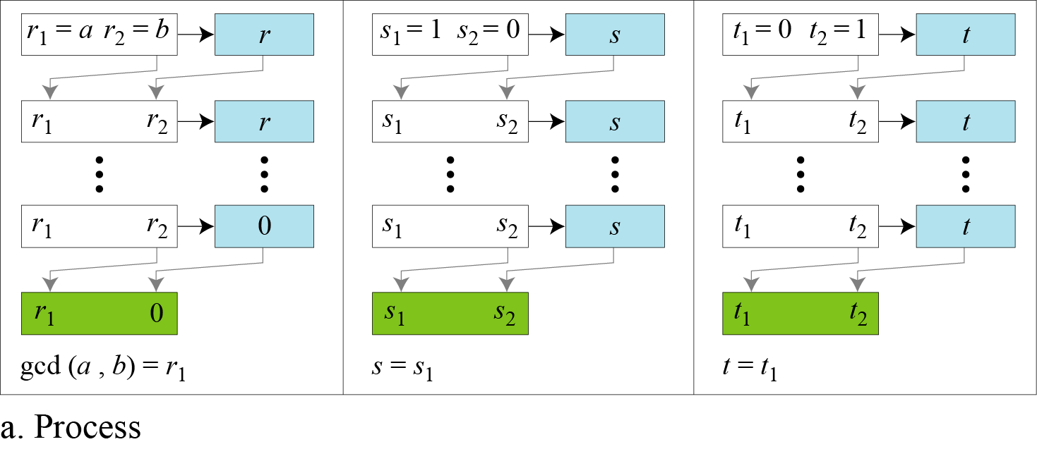
Divisibility(cont.)
Extended Euclidean algorithm, part a

Slide 21
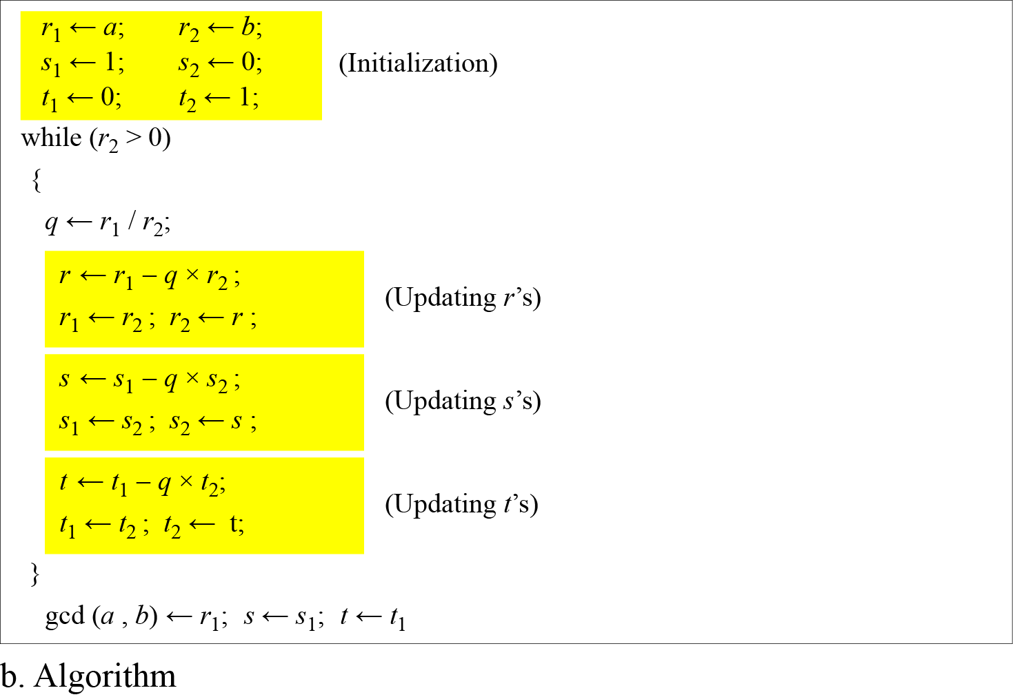
Divisibility(cont.)
Extended Euclidean algorithm, part b

Slide 22
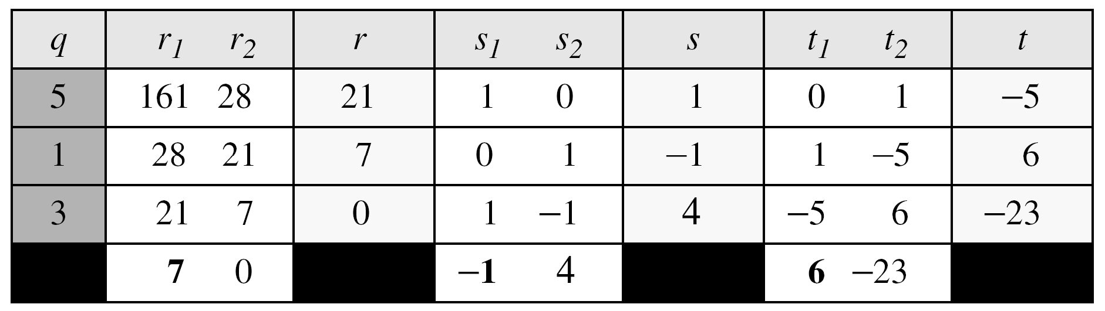
Divisibility(cont.)
Given a = 161 and b = 28, find gcd (a, b) and the values of s and t.
Solution
We get gcd (161, 28) = 7, s = −1 and t = 6.

Slide 23
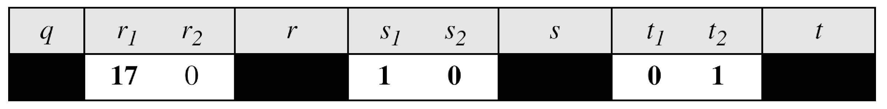
Divisibility(cont.)
Given a = 17 and b = 0, find gcd (a, b) and the values of s and t.
Solution
We get gcd (17, 0) = 17, s = 1, and t = 0

Slide 24
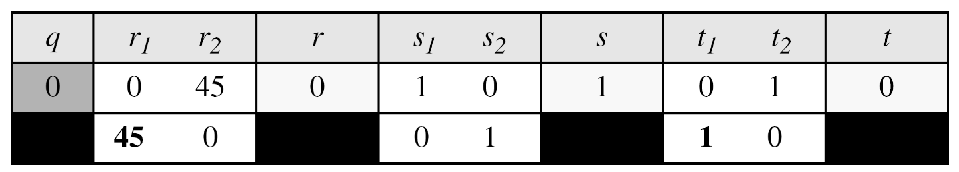
Divisibility(cont.)
Given a = 0 and b = 45, find gcd (a, b) and the values of s and t.
Solution
We get gcd (0, 45) = 45, s = 0, and t = 1.

Slide 25
Divisibility(cont.)
Exercise:
Given a = 84 and b = 320, find gcd (a, b) and the values of s and t.

Slide 26
Divisibility(cont.)
Exercise:
Given a = 84 and b = 320, find gcd (a, b) and the values of s and t.
Solution:
gcd(84,320) = 4, s = -19, t = 5

Slide 27
Modular Arithmetic

Slide 28
Preliminary
The division relationship (a = q × n + r) discussed in the previous section has two inputs (a and n) and two outputs (q and r).
In modular arithmetic, we are interested in only one of the outputs, the remainder r.

Slide 29
Preliminary(cont.)
We use modular arithmetic in our daily life; for example, we use a clock to measure time. Our clock system uses modulo 12 arithmetic. However, instead of a 0 we use the number 12.

Slide 30
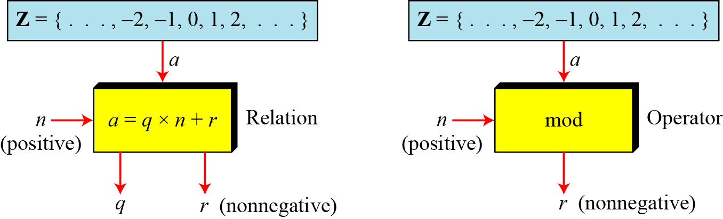
Modulo Operator
The modulo operator is shown as mod. The second input (n) is called the modulus. The output r is called the residue.
Division algorithm and modulo operator

Slide 31
Modulo Operator(cont.)
Find the result of the following operations:
27 mod 5
36 mod 12
−18 mod 14
−7 mod 10

Slide 32
Modulo Operator(cont.)
Solution
Dividing 27 by 5 results in r = 2
Dividing 36 by 12 results in r = 0
Dividing −18 by 14 results in r = −4. After adding the modulus r = 10
Dividing −7 by 10 results in r = −7. After adding the modulus to −7, r = 3

Slide 33
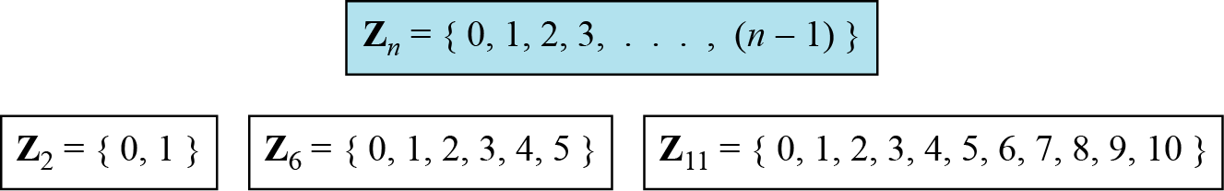
Set of Residues
The modulo operation creates a set, which in modular arithmetic is referred to as the set of least residues modulo n, or Z_{n}.
Some Z_{n} sets

Slide 34
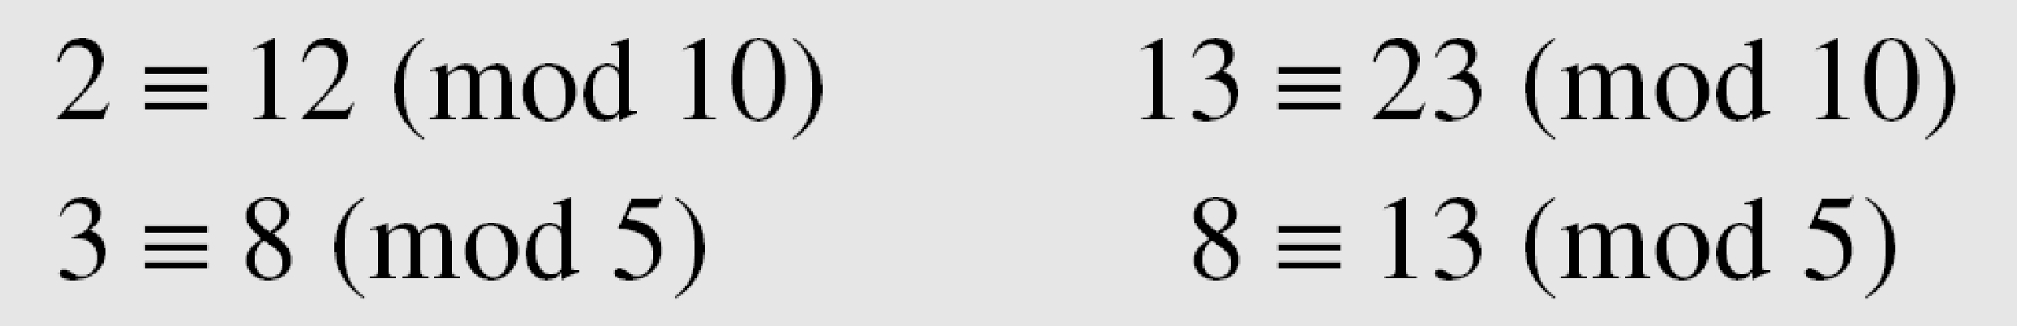
Congruence
To show that two integers are congruent, we use the congruence operator ( ≡ ). For example, we write:

Slide 35
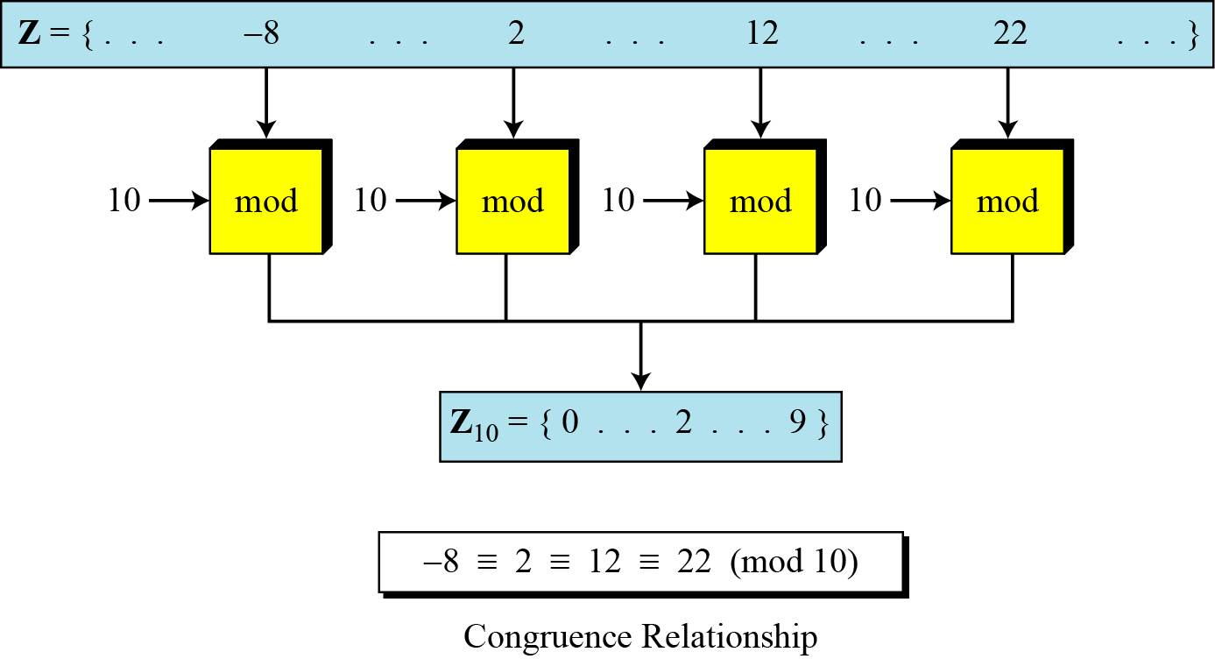
Congruence(cont.)

Slide 36
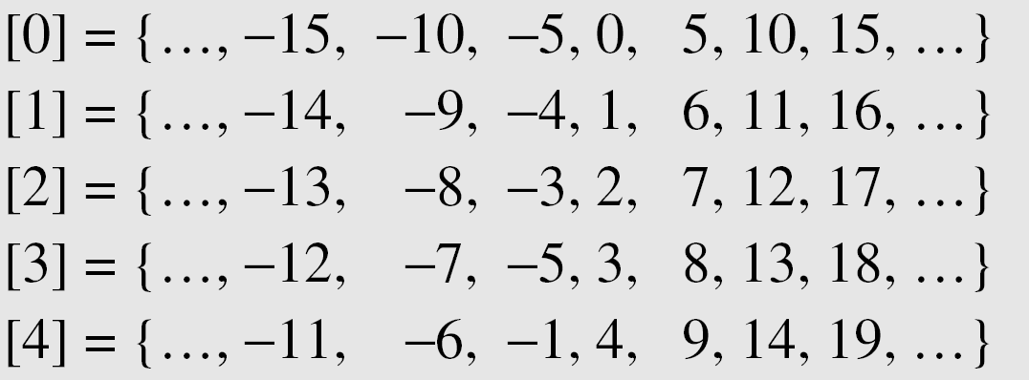
Congruence(cont.)
Residue Classes
A residue class [a] or [a]_{n} is the set of integers congruent modulo n.
It is the set of all integers such that x=a(mod)n
E.g. for n=5, we have five sets as shown below:

Slide 37
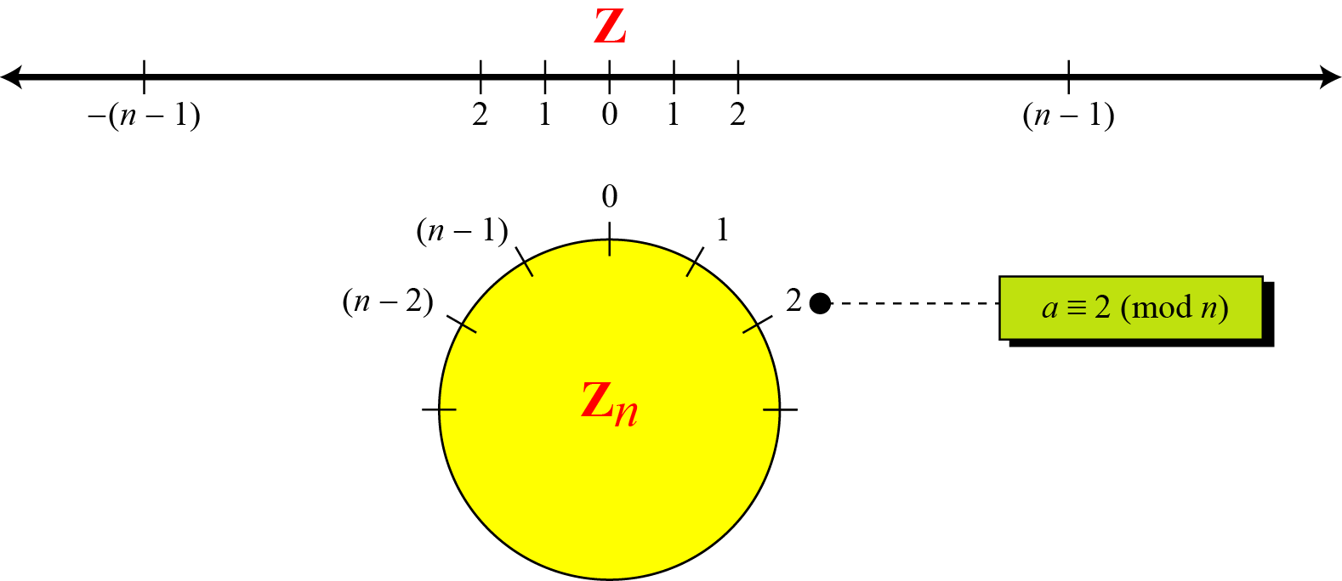
Congruence(cont.)
Comparison of Z and Zn using graphs

Slide 38
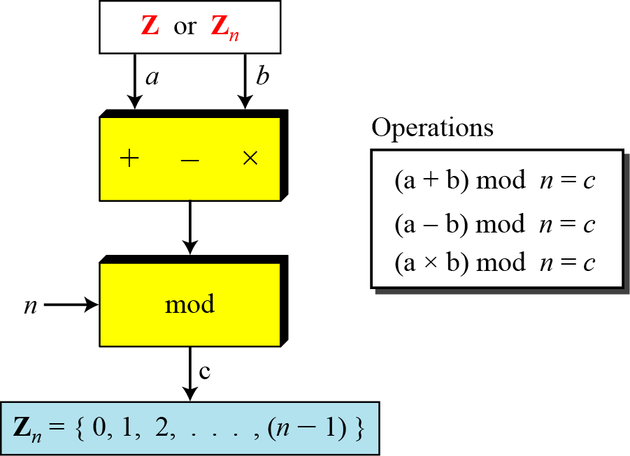
Operation in Zn
The three binary operations that we discussed for the set Z can also be defined for the set Zn. The result may need to be mapped to Zn using the mod operator.

Slide 39
Operation in Z_{n}(cont.)
Perform the following operations (the inputs come from Z_{n}):
a. Add 7 to 14 in Z₁₅.
b. Subtract 11 from 7 in Z₁₃.
c. Multiply 11 by 7 in Z₂₀.

Slide 40
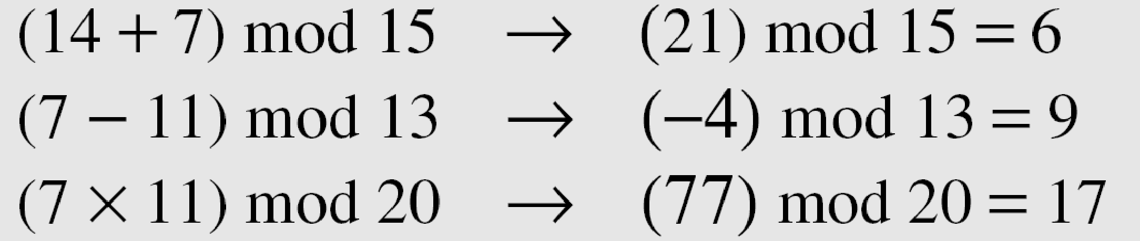
Operation in Z_{n}(cont.)
Solution

Slide 41
Operation in Z_{n}(cont.)
Perform the following operations (the inputs come from either Z or Z_{n}):
a. Add 17 to 27 in Z₁₄.
b. Subtract 43 from 12 in Z₁₃.
c. Multiply 123 by −10 in Z₁₉.

Slide 42
Operation in Z_{n}(cont.)
Solution
Add 17 to 27 in Z₁₄.
(17+27)mod 14 = 2
Subtract 43 from 12 in Z₁₃.
(12-43)mod 13 = 5
Multiply 123 by −10 in Z₁₉.
(123 x (-10)) mod 19 = 5

Slide 43
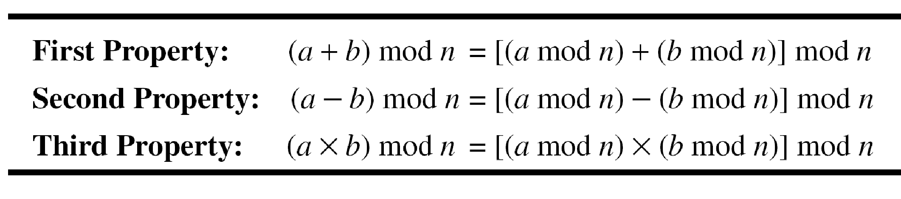
Operation in Z_{n}(cont.)

Slide 44
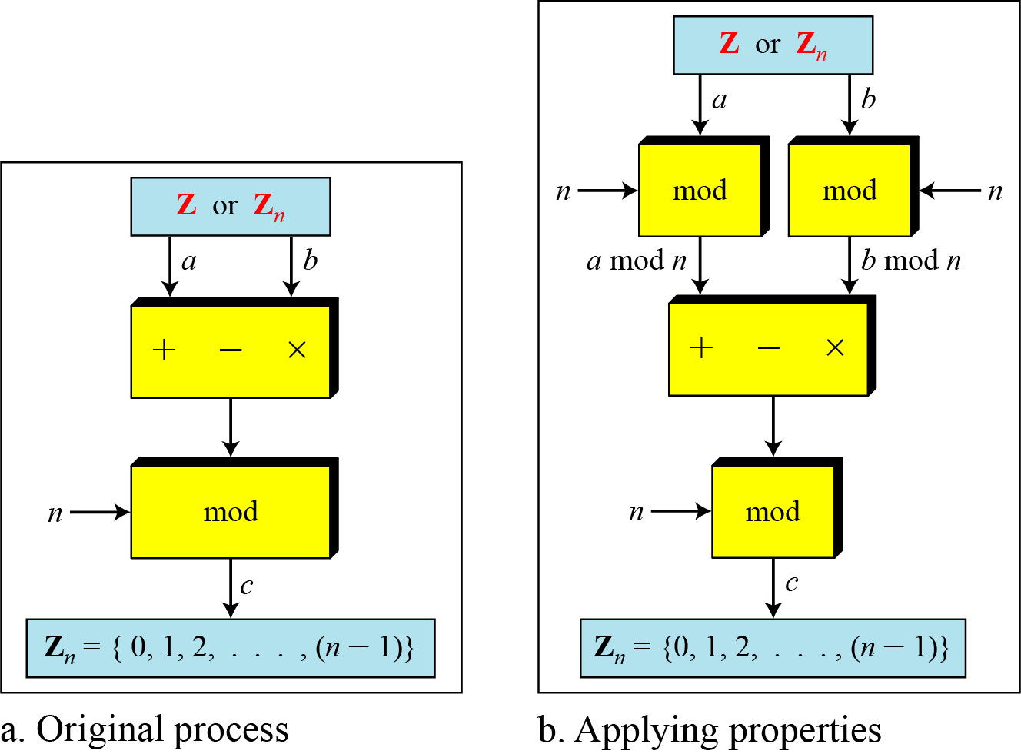
Operation in Z_{n}(cont.)

Slide 45
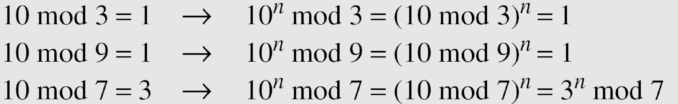
Operation in Z_{n}(cont.)
In arithmetic, we often need to find the remainder of powers of 10 when divided by an integer.

Slide 46
Operation in Z_{n}(cont.): Exercise
We have been told in arithmetic that the remainder of an integer divided by 3 is the same as the remainder of the sum of its decimal digits. In other words, the remainder of dividing 6371 by 3 is same as dividing 17 by 3.
Prove this claim using the properties of the mod operator.

Slide 47
Inverses
When we are working in modular arithmetic, we often need to find the inverse of a number relative to an operation.
We are normally looking for an additive inverse (relative to an addition operation) or a multiplicative inverse (relative to a multiplication operation).

Slide 48

Additive Inverses
In Z_{n}, two numbers a and b are additive inverses of each other if
In modular arithmetic, each integer has an additive inverse. The sum of an integer and its additive inverse is congruent to 0 modulo n.

Slide 49
Additive Inverses
Find all additive inverse pairs in Z₁₀.
Solution
The six pairs of additive inverses are (0, 0), (1, 9), (2, 8), (3, 7), (4, 6), and (5, 5).

Slide 50

Multiplicative Inverses
In Z_{n}, two numbers a and b are the multiplicative inverse of each other if,
In modular arithmetic, an integer may or may not have a multiplicative inverse.
When it does, the product of the integer and its multiplicative inverse is congruent to 1 modulo n.

Slide 51
Multiplicative Inverses(cont.)
Find the multiplicative inverse of 8 in Z₁₀.
There is no multiplicative inverse because gcd (10, 8) = 2 ≠ 1. In other words, we cannot find any number between 0 and 9 such that when multiplied by 8, the result is congruent to 1.
Find all multiplicative inverses in Z₁₀.
There are only three pairs: (1, 1), (3, 7) and (9, 9). The numbers 0, 2, 4, 5, 6, and 8 do not have a multiplicative inverse.

Slide 52
Multiplicative Inverses(cont.)
Find all multiplicative inverse pairs in Z₁₁.

Slide 53
Multiplicative Inverses(cont.)
Find all multiplicative inverse pairs in Z₁₁.
Solution
We have seven pairs: (1, 1), (2, 6), (3, 4), (5, 9), (7, 8), (9, 9), and (10, 10).

Slide 54
Multiplicative Inverses(cont.)
The extended Euclidean algorithm finds the multiplicative inverses of b in Zn when n and b are given and gcd (n, b) = 1.
The multiplicative inverse of b is the value of t after being mapped to Zn.

Slide 55
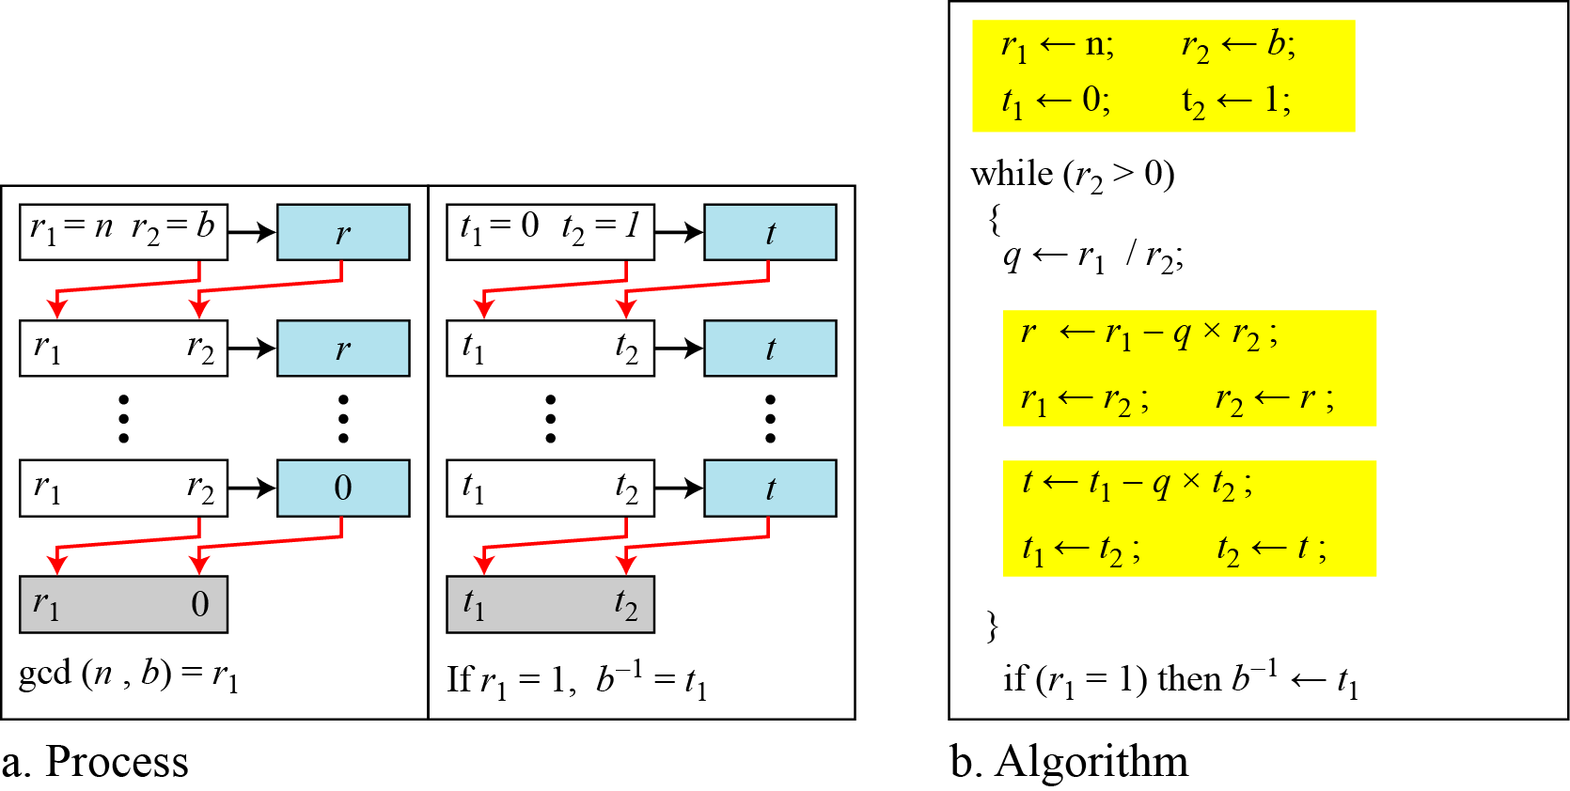
Multiplicative Inverses(cont.)
Using extended Euclidean algorithm to find multiplicative inverse

Slide 56
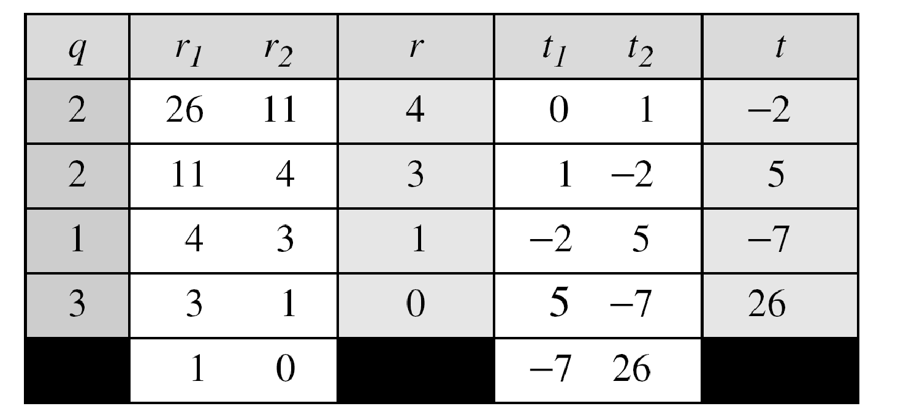
Multiplicative Inverses(cont.)
Find the multiplicative inverse of 11 in Z₂₆.
Solution
The gcd (26, 11) is 1; the inverse of 11 is -7 or 19.

Slide 57
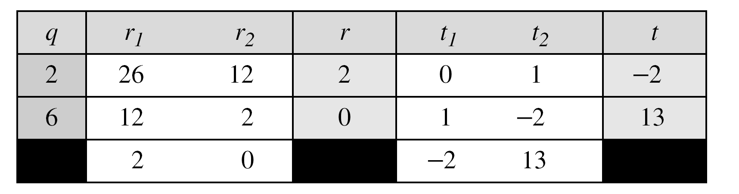
Multiplicative Inverses(cont.)
Find the inverse of 12 in Z₂₆.
Solution
The gcd (26, 12) is 2; the inverse does not exist.

Slide 58
Multiplicative Inverses(cont.)
Find the multiplicative inverse of 23 in Z₁₀₀.

Slide 59
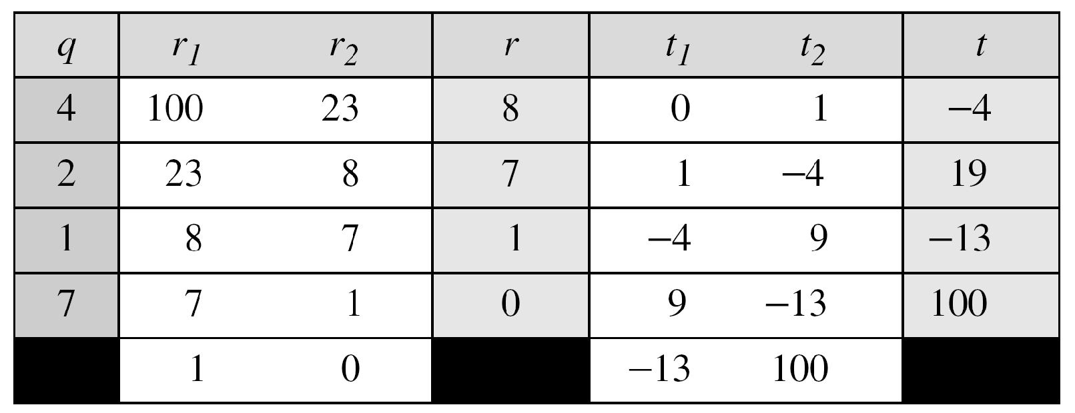
Multiplicative Inverses(cont.)
Find the multiplicative inverse of 23 in Z₁₀₀.
Solution
The gcd (100, 23) is 1; the inverse of 23 is -13 or 87.

Slide 60
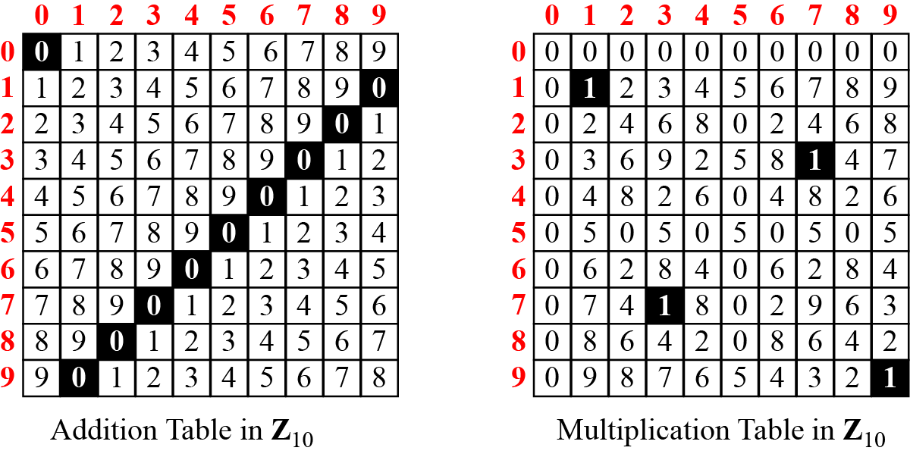
Addition and Multiplication Tables
Addition and multiplication table for Z₁₀

Slide 61
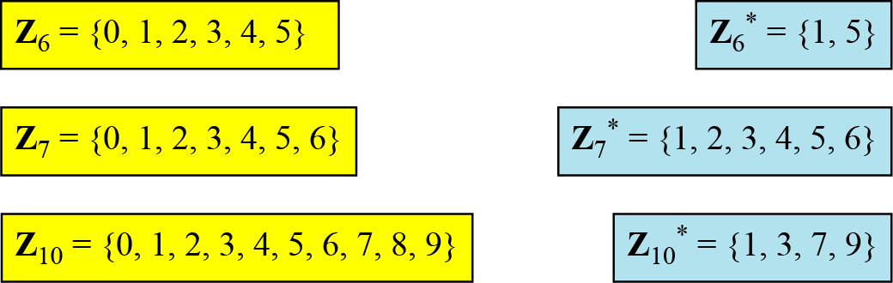
Different Sets
Some Z_{n} and Z_{n*} sets
We need to use Zn when additive inverses are needed; we need to use Zn* when multiplicative inverses are needed.

Slide 62
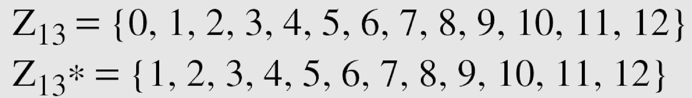
Two More Sets
Cryptography often uses two more sets: Z_{p} and Z_{p}*.
The modulus in these two sets is a prime number.

